Slide 1


Graphics

Slide 2
Announcements

Slide 3
FAQ
What if I didn’t finish Nimm?
Can I see the slides?
Notes:
Type name = value

Slide 4
Review

Slide 5
Variable Declaraion
// Declares an int
int total = 42;
// Changes its value
total = 4;
Notes:
Type name = value

Slide 6
Types
String str = “Hi”;
int num = 5;
double fraction = 0.2

Slide 7

Debug
while(frontIsClear());{
move();
}

Slide 8
Debug
while(frontIsClear()){
move();
}

Slide 9
Debug
if(frontIsClear())
move();
turnLeft();

Slide 10
Debug
if(frontIsClear()) {
move();
turnLeft();
}

Slide 11

Lifetime of a Variable

Slide 12

By Chris

Slide 13
Once upon a time…

Slide 14

x was looking for love…
int x = 5;
if(lookingForLove()) {
int y = 5;
}
println(x + y);
5
x

Slide 15
x was looking for love…
int x = 5;
if(lookingForLove()) {
int y = 5;
}
println(x + y);
5
x

Slide 16
x was looking for love…
x was definitely
looking for love
int x = 5;
if(lookingForLove()) {
int y = 5;
}
println(x + y);
5
x

Slide 17
And met y
int x = 5;
if(lookingForLove()) {
int y = 5;
}
println(x + y);
5
5
x
y

Slide 18
And met y
int x = 5;
if(lookingForLove()) {
int y = 5;
}
println(x + y);
5
5
Hi, I’m y
x
y

Slide 19
“Wow!”

Slide 20
And met y
int x = 5;
if(lookingForLove()) {
int y = 5;
}
println(x + y);
Wow
5
5
x
y

Slide 21
And met y
int x = 5;
if(lookingForLove()) {
int y = 5;
}
println(x + y);
5
5
We have so much in common
x
y

Slide 22
And met y
int x = 5;
if(lookingForLove()) {
int y = 5;
}
println(x + y);
5
5
We both have value 5!
x
y

Slide 23
And met y
int x = 5;
if(lookingForLove()) {
int y = 5;
}
println(x + y);
5
5
Maybe one day we can…
x
y

Slide 24
And met y
int x = 5;
if(lookingForLove()) {
int y = 5;
}
println(x + y);
5
5
println together?
x
y

Slide 25
They got along
int x = 5;
if(lookingForLove()) {
int y = 5;
}
println(x + y);
5
5
x
y

Slide 26
It was a beautiful match…

Slide 27
But then tragedy struck.

Slide 28
Tragedy Struck
int x = 5;
if(lookingForLove()) {
int y = 5;
}
println(x + y);
5
5
x
y

Slide 29
Tragedy Struck
int x = 5;
if(lookingForLove()) {
int y = 5;
}
println(x + y);
5
5
x
y

Slide 30
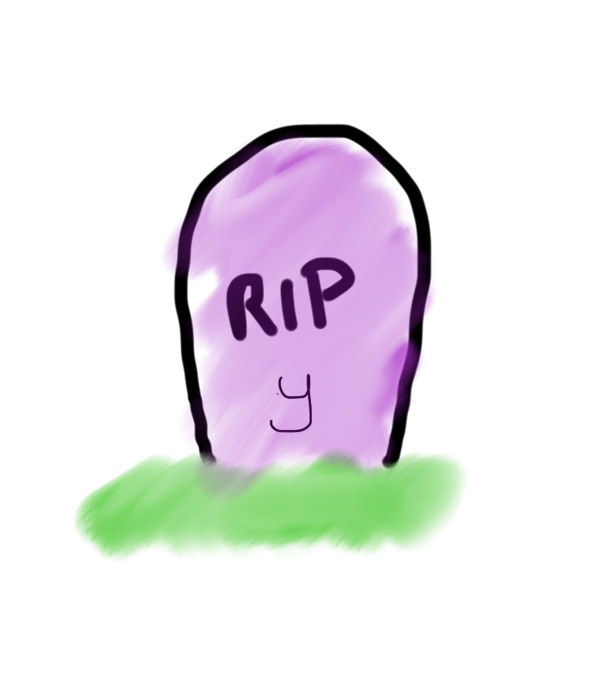
Tragedy Struck
int x = 5;
if(lookingForLove()) {
int y = 5;
}
println(x + y);
5
x

Slide 31
Noooooooooooooooo!

Slide 32
You see…

Slide 33
When a program exits the code block…
int x = 5;
if(lookingForLove()) {
int y = 5;
}
println(x + y);
5
x

Slide 34
Where a variable was declared…
int x = 5;
if(lookingForLove()) {
int y = 5;
}
println(x + y);
5
x

Slide 35
It gets deleted from memory!
int x = 5;
if(lookingForLove()) {
int y = 5;
}
println(x + y);
5
x

Slide 36
Since y was declared inside the if
int x = 5;
if(lookingForLove()) {
int y = 5;
}
println(x + y);
5
x

Slide 37
It gets deleted from memory here
int x = 5;
if(lookingForLove()) {
int y = 5;
}
println(x + y);
5
x

Slide 38
And doesn’t exist here.
int x = 5;
if(lookingForLove()) {
int y = 5;
}
println(x + y);
5
x

Slide 39
And doesn’t exist here.
Error. Undefined variable y.
int x = 5;
if(lookingForLove()) {
int y = 5;
}
println(x + y);
5
x

Slide 40
The End

Slide 41
Sad times ☹

Slide 42
Variables have a lifetime
public void run(){
double v = 8;
if(condition){
v = 4;
… some code
}
… some other code
}

Slide 43
Variables have a lifetime
public void run(){
double v = 8;
if(condition){
v = 4;
… some code
}
… some other code
}

Slide 44
Come to existence when declared
public void run(){
double v = 8;
if(condition){
v = 4;
… some code
}
… some other code
}
Comes to life here
8
v

Slide 45
Live Until End of Code-Block
public void run(){
double v = 8;
if(condition){
v = 4;
… some code
}
… some other code
}
This is the inner most
code block in which it was
declared….
4
v

Slide 46
Variables have a lifetime
public void run(){
double v = 8;
if(condition){
v = 4;
… some code
}
… some other code
}
Still alive here…
4
v

Slide 47
Live Until End of Code-Block
public void run(){
double v = 8;
if(condition){
v = 4;
… some code
}
… some other code
}
4
v
It dies here (at the end of its code block)

Slide 48

Live Until End of Code-Block
public void run(){
double v = 8;
if(condition){
v = 4;
… some code
}
… some other code
}
It dies here (at the end of its code block)

Slide 49
Chapter 2

Slide 50
The programmer fixed her bug

Slide 51
x was looking for love…
int x = 5;
if(lookingForLove()) {
int y = 5;
println(x + y);
}
5
x

Slide 52
x was looking for love…
x was definitely
looking for love
int x = 5;
if(lookingForLove()) {
int y = 5;
println(x + y);
}
5
x

Slide 53
x met y
int x = 5;
if(lookingForLove()) {
int y = 5;
println(x + y);
}
5
5
x
y

Slide 54
Since they were both in scope…
int x = 5;
if(lookingForLove()) {
int y = 5;
println(x + y);
}
5
5
x
y

Slide 55
The story had a happy ending!

Slide 56
End Review

Slide 57
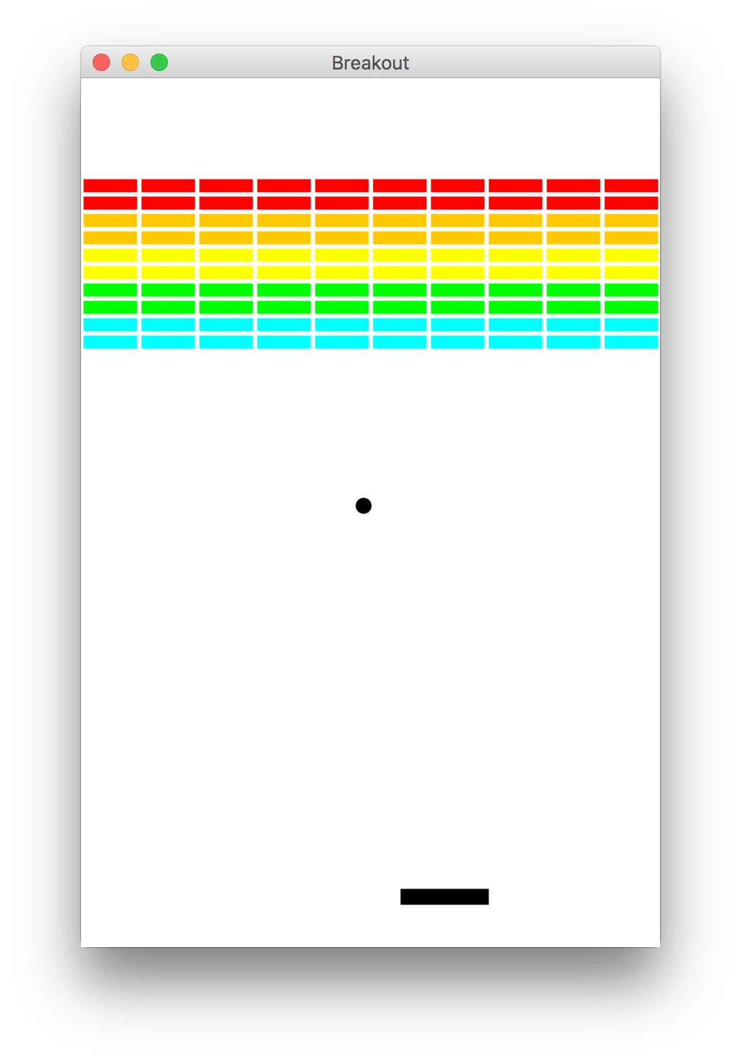
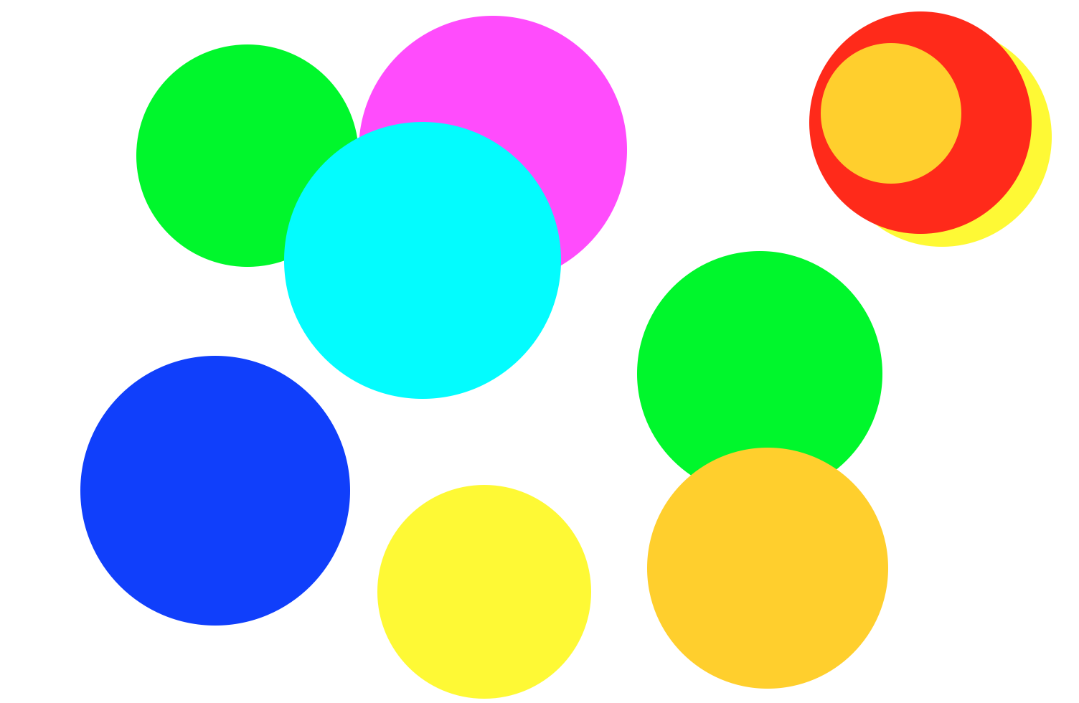
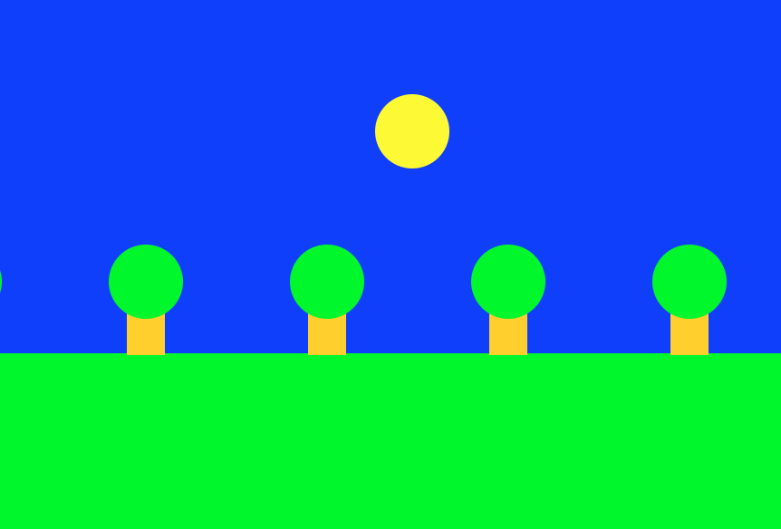
Beyond Console Programs

Slide 58
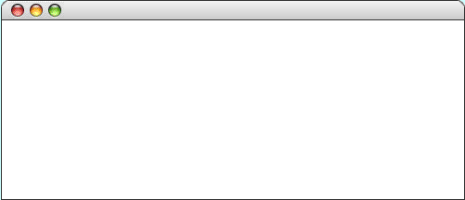
GRect
GRect is a variable that stores a rectangle.
As an example, the following run method displays a rectangle
public void run() {
Grect rect = new GRect(200, 200);
rect.setFilled(true);
rect.setColor(Color.BLUE);
add(rect, 50, 50);
}
LargestOval

Slide 59
Graphics Coordinates
0,0
40,20
120,40
getHeight();
40,120
getWidth();

Slide 60
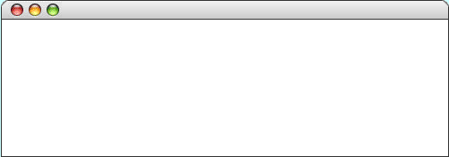
GLabel
A variable that represents text.
public class HelloProgram extends GraphicsProgram {
public void run() {
GLabel label = new GLabel("hello, world", 100, 75);
label.setFont("SansSerif-36");
label.setColor(Color.RED);
add(label);
}
}
HelloProgram

Slide 61
GLabel
A variable that represents text.
public class HelloProgram extends GraphicsProgram {
public void run() {
GLabel label = new GLabel("hello, world", 100, 75);
label.setFont("SansSerif-36");
label.setColor(Color.RED);
add(label);
}
}
HelloProgram

Slide 62
GLabel
A variable that represents text.
public class HelloProgram extends GraphicsProgram {
public void run() {
GLabel label = new GLabel("hello, world", 100, 75);
label.setFont("SansSerif-36");
label.setColor(Color.RED);
add(label);
}
}
HelloProgram

Slide 63
GLabel
A variable that represents text.
public class HelloProgram extends GraphicsProgram {
public void run() {
GLabel label = new GLabel("hello, world", 100, 75);
label.setFont("SansSerif-36");
label.setColor(Color.RED);
add(label);
}
}
HelloProgram

Slide 64
GLabel
A variable that represents text.
public class HelloProgram extends GraphicsProgram {
public void run() {
GLabel label = new GLabel("hello, world", 100, 75);
label.setFont("SansSerif-36");
label.setColor(Color.RED);
add(label);
}
}
HelloProgram
hello, world

Slide 65
GOval
The GOval class represents an elliptical shape defined by the boundaries of its enclosing rectangle.
As an example, the following run method creates the largest oval that fits within the canvas:
public void run() {
GOval oval = new GOval(getWidth(), getHeight());
oval.setFilled(true);
oval.setColor(Color.GREEN);
add(oval, 0, 0);
}
LargestOval

Slide 66
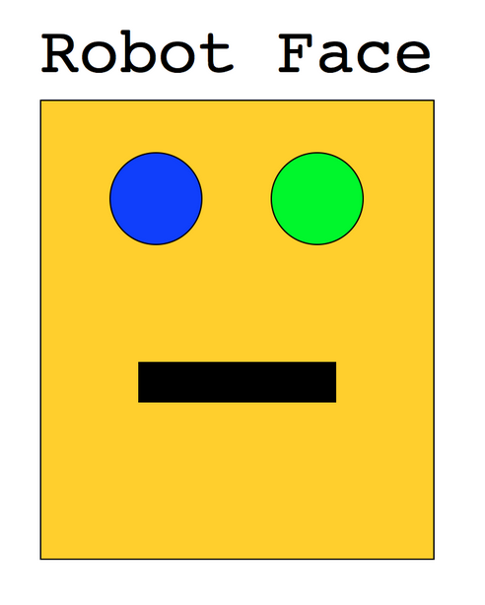
Karel’s Grandpa

Slide 67
Graphics Methods
add(object)
Adds the object to the canvas at the front of the stack
add(object, x, y)
Moves the object to (x, y) and then adds it to the canvas
remove(object)
Removes the object from the canvas
removeAll()
Removes all objects from the canvas
getElementAt(x, y)
Returns the frontmost object at (x, y), or null if none
getWidth()
Returns the width in pixels of the entire canvas
getHeight()
Returns the height in pixels of the entire canvas
setBackground(c)
Sets the background color of the canvas to c.
pause(milliseconds)
Pauses the program for the specified time in milliseconds
waitForClick()
Suspends the program until the user clicks the mouse

Slide 68
Graphics Methods
add(object)
Adds the object to the canvas at the front of the stack
add(object, x, y)
Moves the object to (x, y) and then adds it to the canvas
remove(object)
Removes the object from the canvas
removeAll()
Removes all objects from the canvas
getElementAt(x, y)
Returns the frontmost object at (x, y), or null if none
getWidth()
Returns the width in pixels of the entire canvas
getHeight()
Returns the height in pixels of the entire canvas
setBackground(c)
Sets the background color of the canvas to c.
pause(milliseconds)
Pauses the program for the specified time in milliseconds
waitForClick()
Suspends the program until the user clicks the mouse

Slide 69
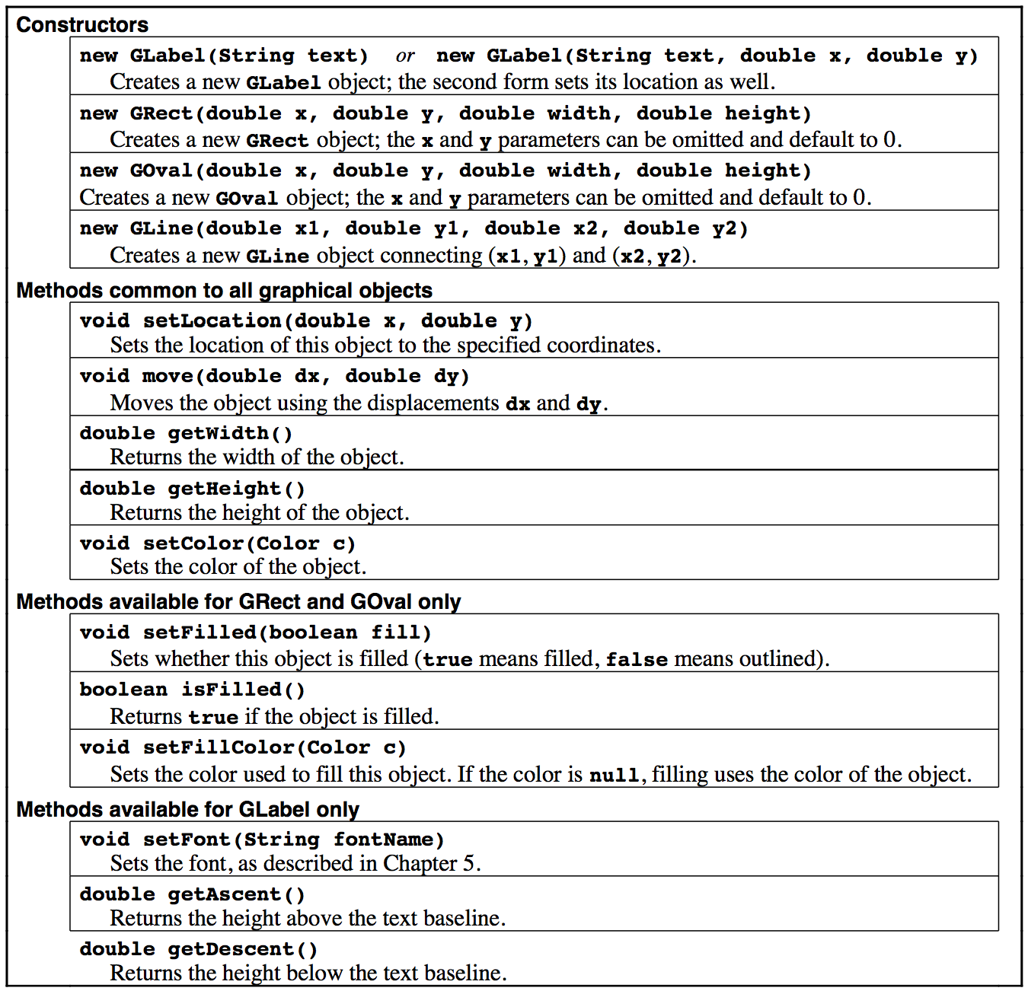
Reference Sheet

Slide 70

That’s All

